Slide 1
CSE487 Cybersecurity, Law and Ethics
Instructor: Rashedul Amin Tuhin (RDA)
Senior Lecturer, Department of CSE
East West University

Slide 2

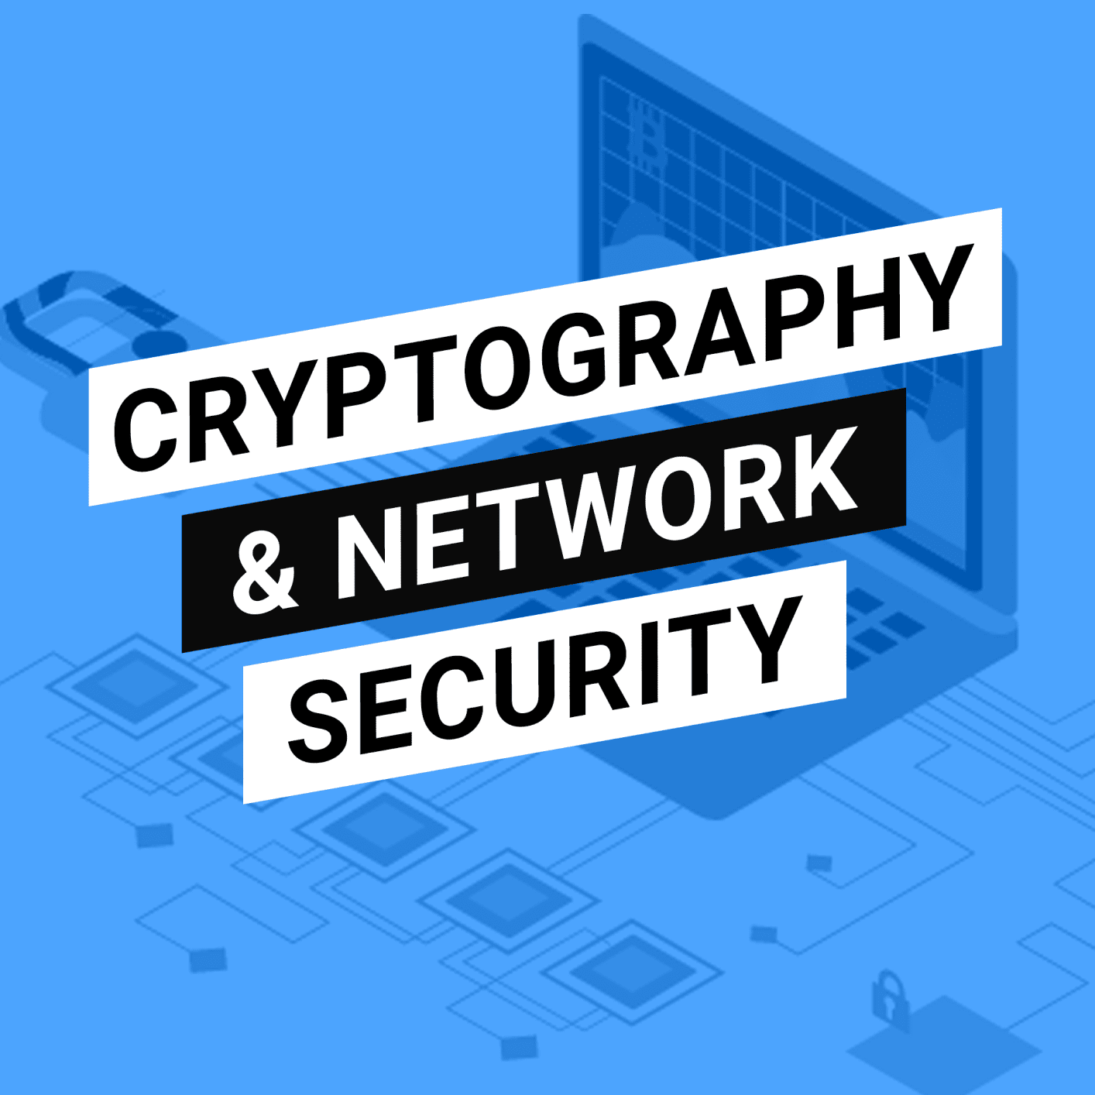

NESO ACADEMY
Cryptography & Network Security
Cryptography & Network Security

Slide 3
Topics to be covered
Introduction to Cryptography
Mathematical Background - Abstract Algebra and Number Theory
Block Ciphers
Public Key Cryptography
Cryptographic Hash Functions and Digital Signatures
Security Practices and System Security.
Email, IP and Web Security

Slide 4
Outcomes of the lecture
At the end of the module the students will be able to:
Understand the need of security of networked systems.
Know various intentions of attacker.
Define “Computer Security”.
Know the key objectives of computer security.
Understand the CIA Triad.
Know the various levels of impact of security breach.

Slide 5
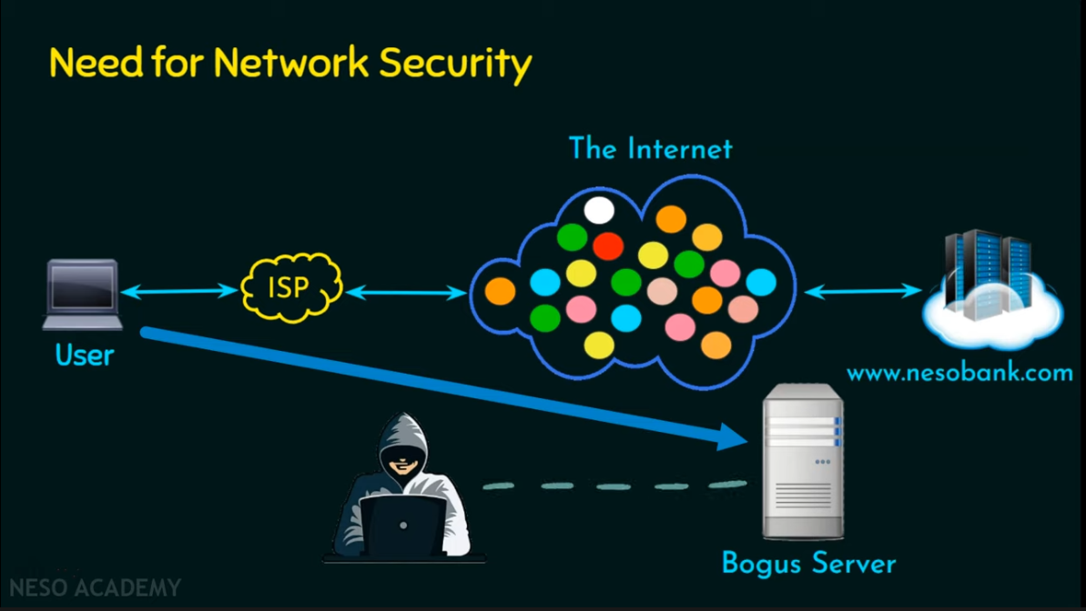
Image Coursey: Neso Academy

Slide 6
Definition of Computer Security
According to the NIST,
The protection afforded to an automated information system in order to attain the applicable objectives of preserving the integrity, availability, and confidentiality of information system resources (includes hardware, software, firmware, information/data and telecommunications)

Slide 7
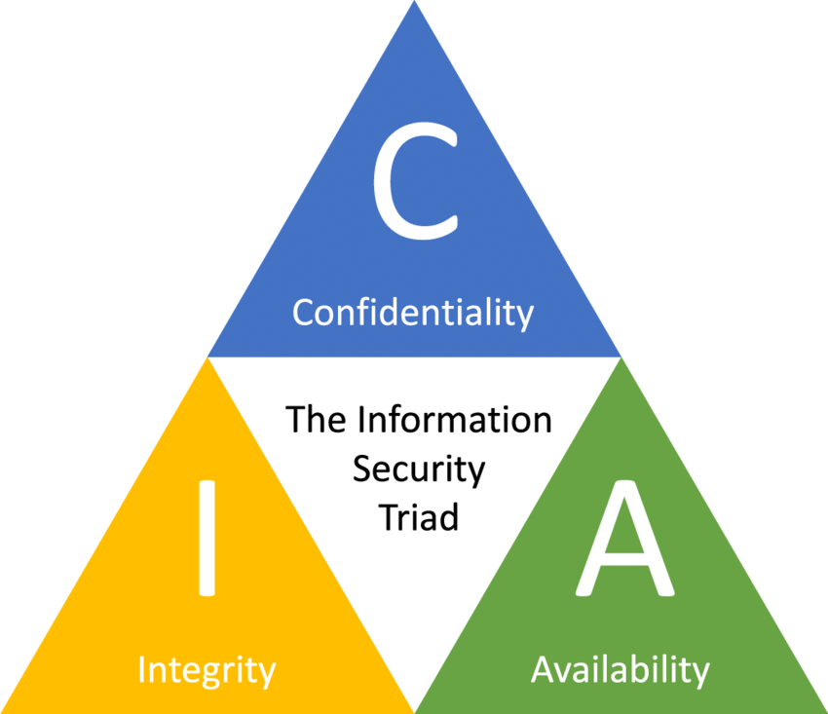
The CIA Triad
Confidentiality
Integrity
Availability
Additional:
Authenticity
Accountability

Slide 8
Examples of CIA Triad
Confidentiality (Example: Account information)
Integrity (Example: Patient’s information)
Availability (Example: Authentication service)

Slide 9
Levels of impact of security breach
Low level impact (limited adverse effect on organization's operation or organizational assets or individual, the system is affected with minor harm or minor damage in terms of financial and physical aspects, effect of the attack is negligible)
Medium (Significant loss to the organization, loss of life and asset)
High (Catastrophic adverse effect on the organization)

Slide 10
Outcomes
Know the difference between threat and attack.
Understand the OSI security architecture
Know about security attacks, security services and security mechanisms.

Slide 11
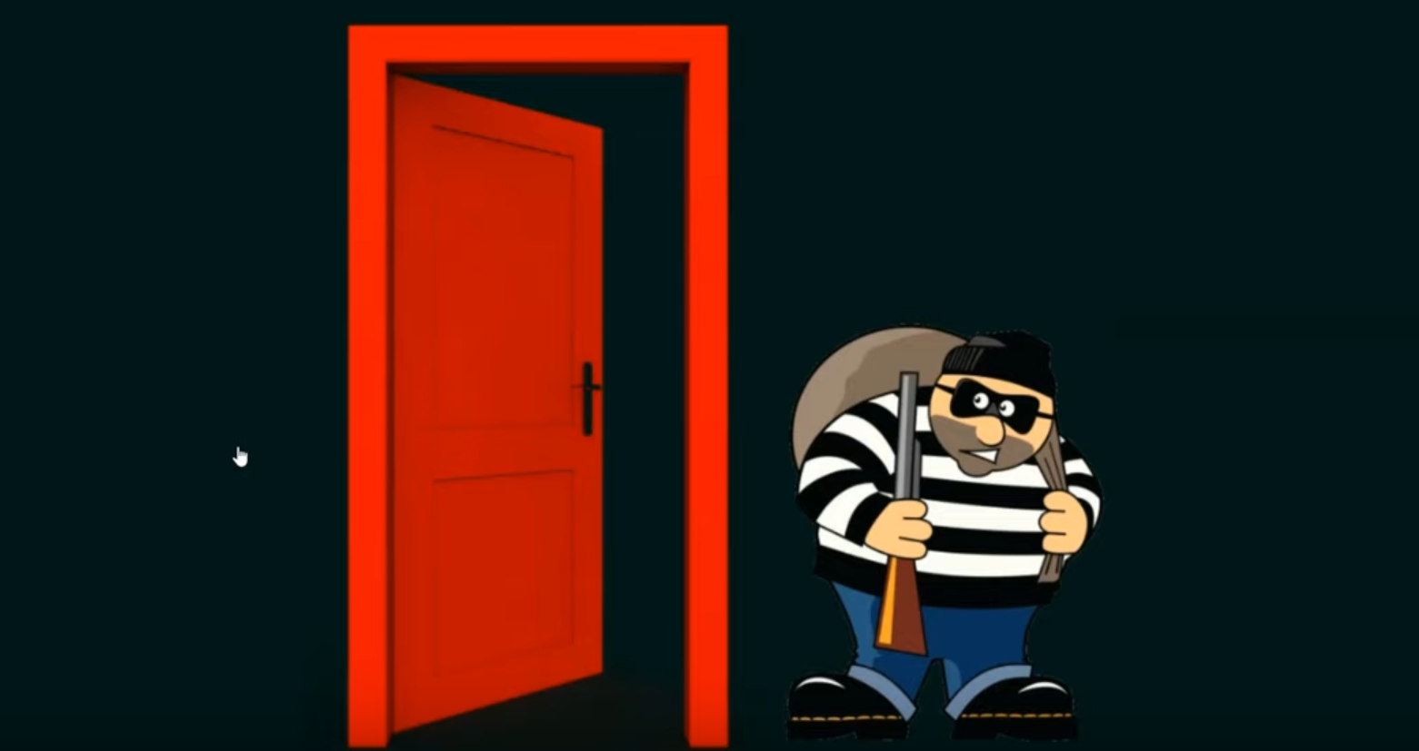

Slide 12
Threats and Attacks (RFC 2828/4949)
Threat: A potential for violation of security, which exists when there is a circumstance, capability, action or event that could bridge security and cause harm. That is, a threat is a possible danger that might exploit a vulnerability.
Attack: An assault on system security that derives from an intelligent threat; That is, and intelligent act that is a deliberate attempt (especially in that sense of a method or technique) to evade security services and violate the security policy of a system.

Slide 13
The OSI Security Architecture
Security Attack: Action that compromises the security.
Security Mechanism: Detect, prevent, or recover from a security attack.
Security Service: Enhance the security, counter security attacks and provide the service.

Slide 14
Security Attacks
Definition:
Action that compromise the security of an individual or an organization.
Types:
Passive Attack
Active Attack

Slide 15
Security Mechanisms
Encipherment
Digital Signature
Access Control
Data Integrity
Authentication Exchange
Traffic Padding
Routing Control
Notarization

Slide 16
Security Services
Authentication
Access Control
Data Confidentiality
Data Integrity
Non-Repudiation
[Learn more from RFC 2828 and X.800: https://www.itu.int/rec/T-REC-X.800/_page.print]

Slide 17
Outcomes
Understand various passive attacks
Understand various active attacks
Know the difference between passive and active attacks

Slide 18
Passive Attack
Attempts to learn or make use of information from the system (unauthorized reading of the message without modification)
Does not affect system resources.
Eavesdropping or monitoring of transmissions.
Goal: Obtain information that is being transmitted.
Types:
Release of message contents (Information disclosure)
Traffic Analysis (Learning the details of the communication)

Slide 19
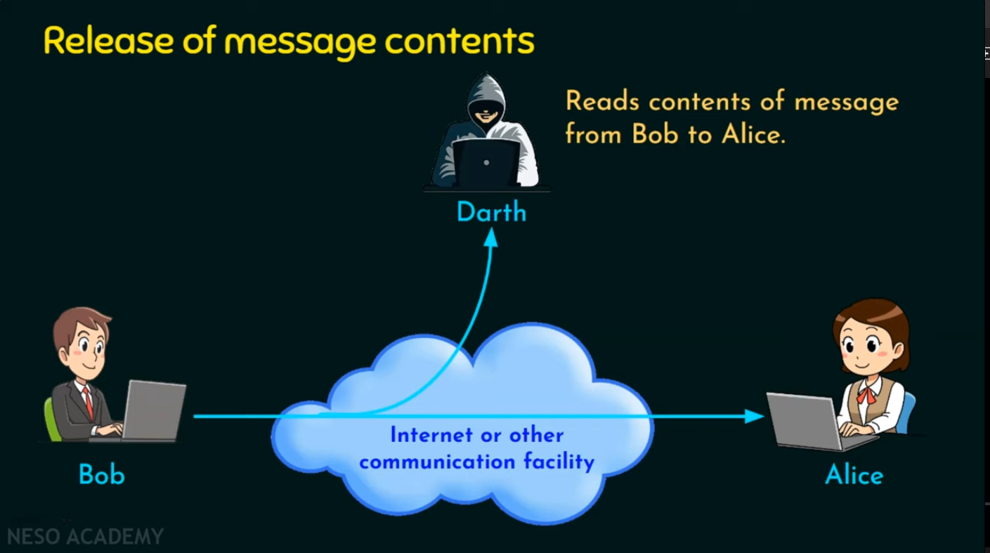

Slide 20
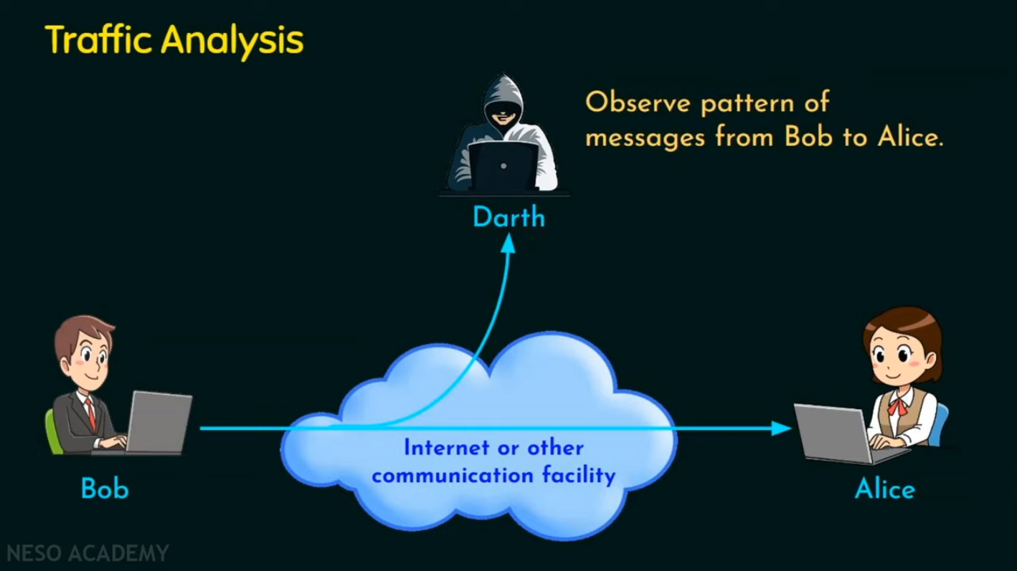

Slide 21
Active Attack
Active attacks involve some modification of the data stream or the creation of a false stream.
Types:
Masquerade
Replay
Modification of messages
Denial of service (DoS)

Slide 22
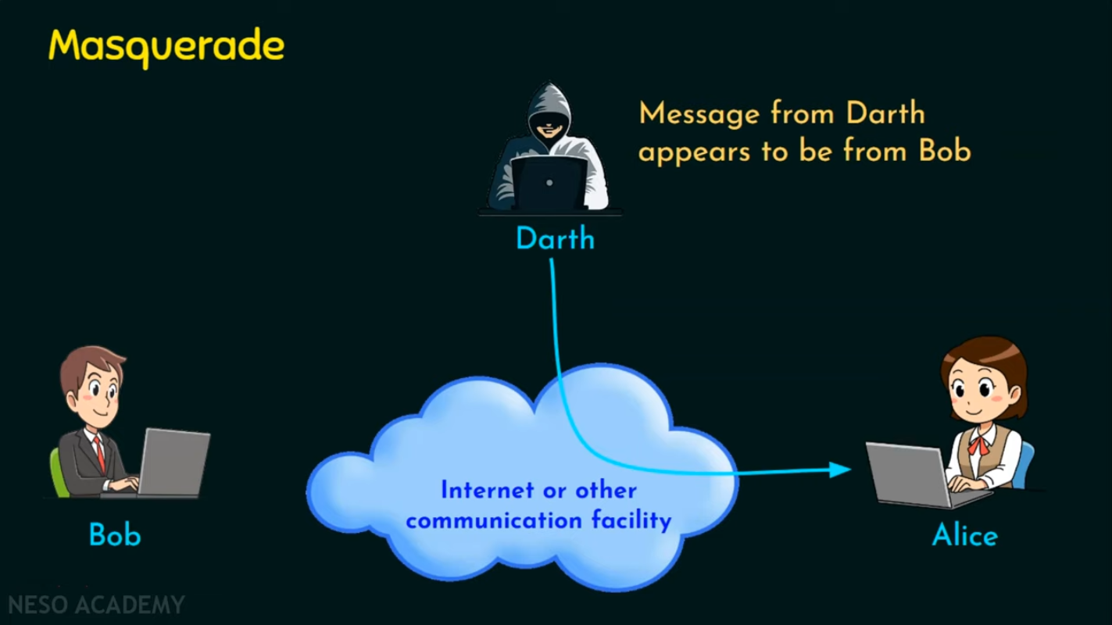

Slide 23
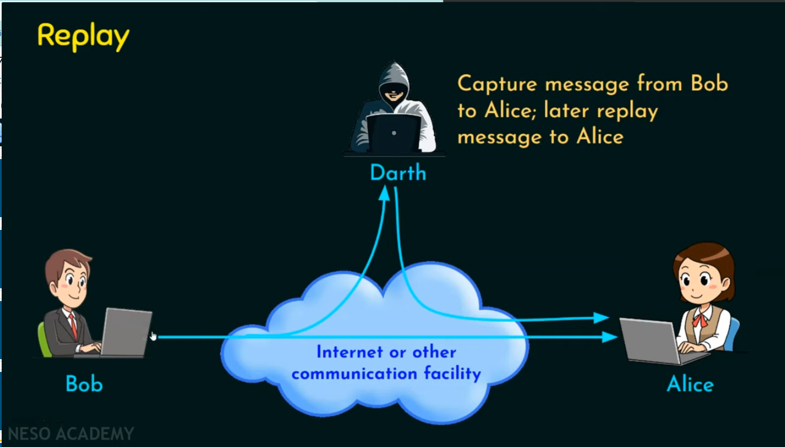

Slide 24
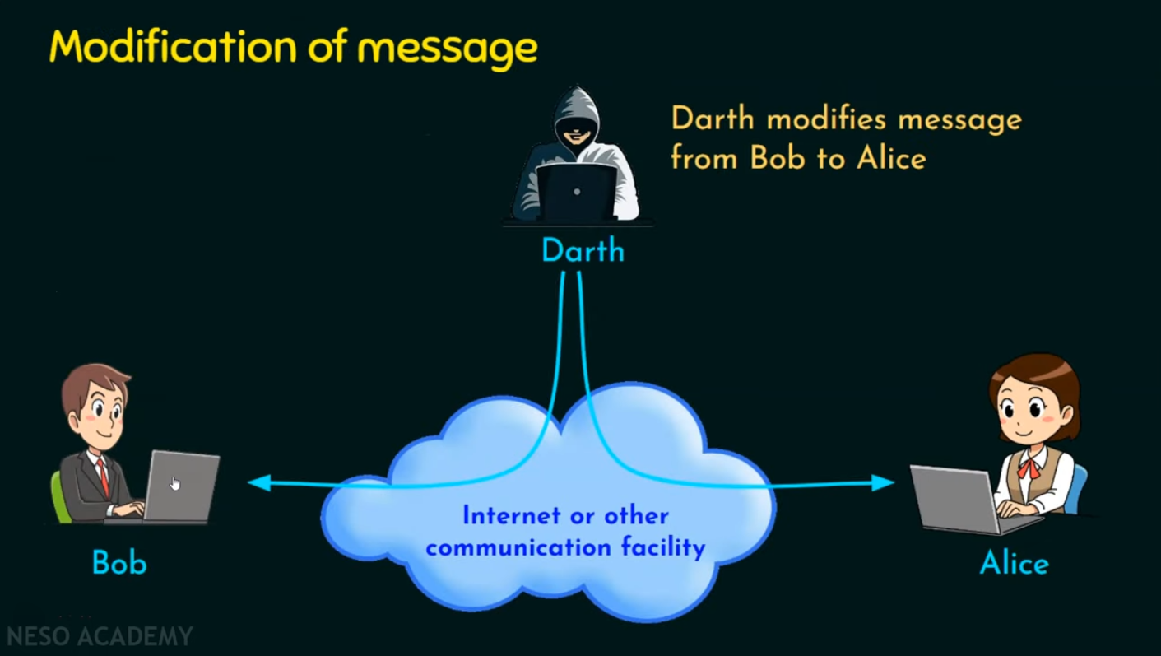

Slide 25
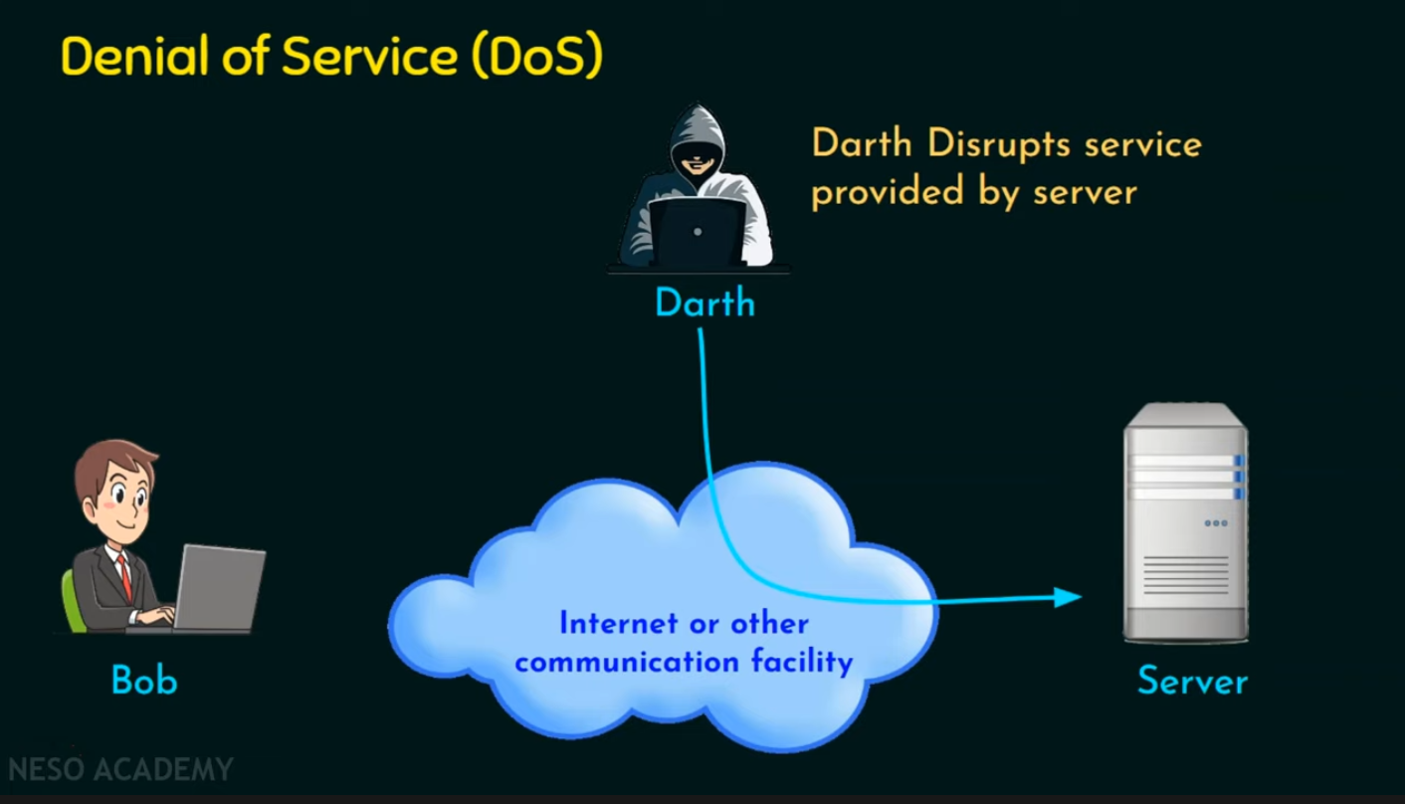

Slide 26
Passive attack vs. Active attack
Passive Attack
Hard to detect
Neither sender nor receiver is aware of the attack
Encryption prevents the success of the passive attacks
More emphasis is on prevention than detection
Active Attack
Hard to prevent
Difficult to prevent- physical, software and network vulnerabilities
Detect and recover from any disruption or delays.
if the direction has a deterrent effect it may also contribute to prevention.

Slide 27
Outcomes
Understand various security services

Slide 28
Security Services - Definition
The processing or communication service that is provided by a system to give a specific kind of protection to system resources.
Security services implement security policies and are implemented by security mechanisms.
[RFC 2828]

Slide 29
Security Services
Authentication
Peer entity authentication
Data origin authentication
Access control
Data confidentiality
Data integrity
Non-repudiation

Slide 30
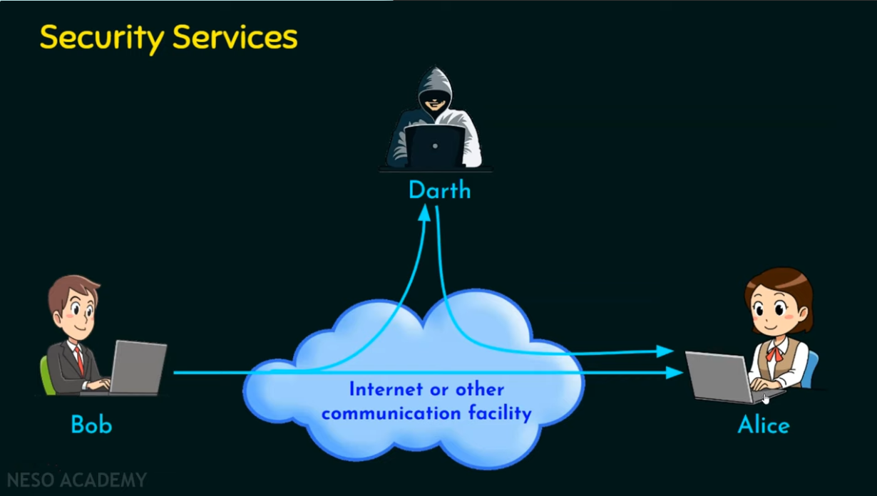

Slide 31
Security Mechanism
Security services implement security policies and are implemented by security mechanisms.
Specific security mechanisms
Pervasive security mechanisms

Slide 32
Specific Security Mechanisms
Encipherment (Goal: Data confidentiality)
Digital Signature (Goal: Prove the identity, i.e., Authentication)
Access Control (Goal: Restrict access)
Data Integrity (Goal: Detect modification)
Authentication Exchange (Goal: Periodic exchange of authentication)
Traffic Padding (Goal: Dummy data stream to confuse the attacker)
Routing Control (Goal: Source routing to bypass the attacker)
Notarization (Goal: SSL Certificates to vouch for an entity)

Slide 33
Pervasive Security Mechanisms
Trusted Functionality
Security Label
Event Detection
Security Audit Trail
Security Recovery

